Slide 1
Cross-sectional association between blood cholesterol and calcium levels in genetically diverse strains of mice
Cody Cousineau, Kaelin Loftus, Gary A. Churchill and Dave Bridges

Slide 2
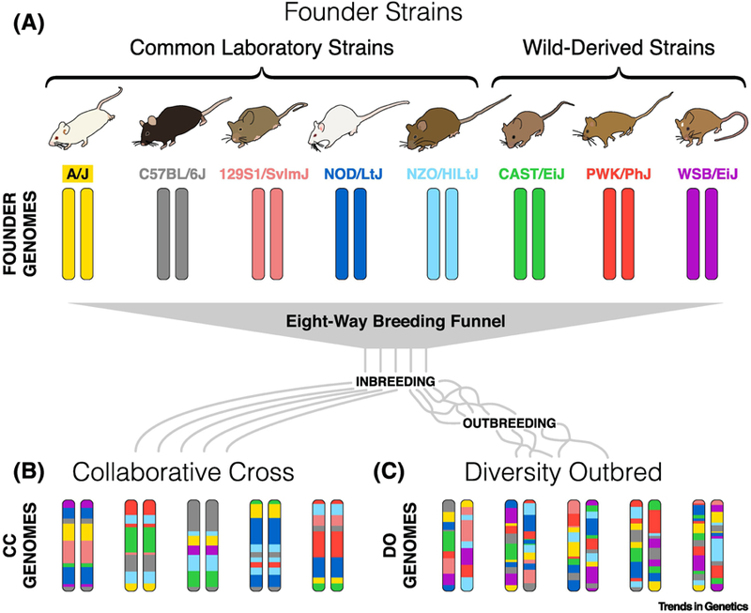
Diversity Outbred Mice
Saul MC, Philip VM, Reinholdt LG; Center for Systems Neurogenetics of Addiction; Chesler EJ. High-Diversity Mouse Populations for Complex Traits. Trends Genet. 2019 Jul;35(7):501-514. doi: 10.1016/j.tig.2019.04.003.
Notes:
CODY: To understand what drives blood cholesterol in mice, we evaluated diversity outbred mice and asked what explains variation in their blood cholesterol. Diversity outbred mice are derived from the inter-breeding of eight founder strains. are genetically unique. We used data from 840 mice, both male and female, randomized to either a control chow diet or a high fat high sucrose diet.
Can you highlight part c of this figure

Slide 3
What Predicts Serum Cholesterol?
Notes:
CODY: We used a machine learning approach called a regression tree, inputing 162 clinical and morphological phenotypes and used these to identify what predicts serum cholesterol.

Slide 4
High Fat, High Sucrose Diets Increases Cholesterol
Notes:
CODY: The first predictor was the diet, with high fat high sucrose diet increasing cholesterol by 33 mg/dL.
DUSTIN: can you highlight the diet branch point

Slide 5
Serum Triglycerides and Cholesterol are Linked
Notes:
CODY: The next best predictor was serum triglycerides. This was expected as hyperlipidemia and hypercholeserolemia are often co-morbid.
DUSTIN: can you highlight the Triglycerides branch point

Slide 6
Serum Calcium is Associated with Cholesterol
Notes:
CODY To our surprise, the next predictor was serum calcium. As you can see, a 1 mg/dL increase in serum choleserol is associated with a 12.7 mg/dL increrase in cholesterol, and this is true in male and female mice, across both diets.
can you highlight the calcium branch point

Slide 7
Notes:
DAVE or CODY: We looked into the literature and several human studies have reported positive associations between calcium and cholesterol, and between serum calcium and cardiovascular disease. This is the first study in mice showing that this relationship is robust across diets and sexes. While we have some hypotheses, we dont yet know whether calcium increases cholesterol, whether cholesterol increases calcium, or if something else drives both, and we look forward to studying this in the future.
can you sequentially increase

Slide 8
Acknowledgements
Kaelin Loftus (University of Michigan)
Gary A. Churchill (The Jackson Laboratories)
Contact us at bridges_lab@umich.edu or bridges_lab on social
UROP
The Jackson Laboratories
NIDDK R01DK107535
NIGMS R01GM070683
Notes:
DAVE: Together these data show the power of using diversity outbred mice as a tool of precision nutrition, allowing us to leverage genetic diversity under conditions of exceptional dietary and environmenal control. We would like to thank both Kaelin Loftus and Gary Churchill for their work on this study, and for funding from the Undergraduate Research Opportunities Program at the University of Michgian, The Jackson Laboratories and National Institutes of Health. If you have any questions or thoughts about our study please contact us at bridges_lab umich.edu or on X at bridges_lab

